Slide 1

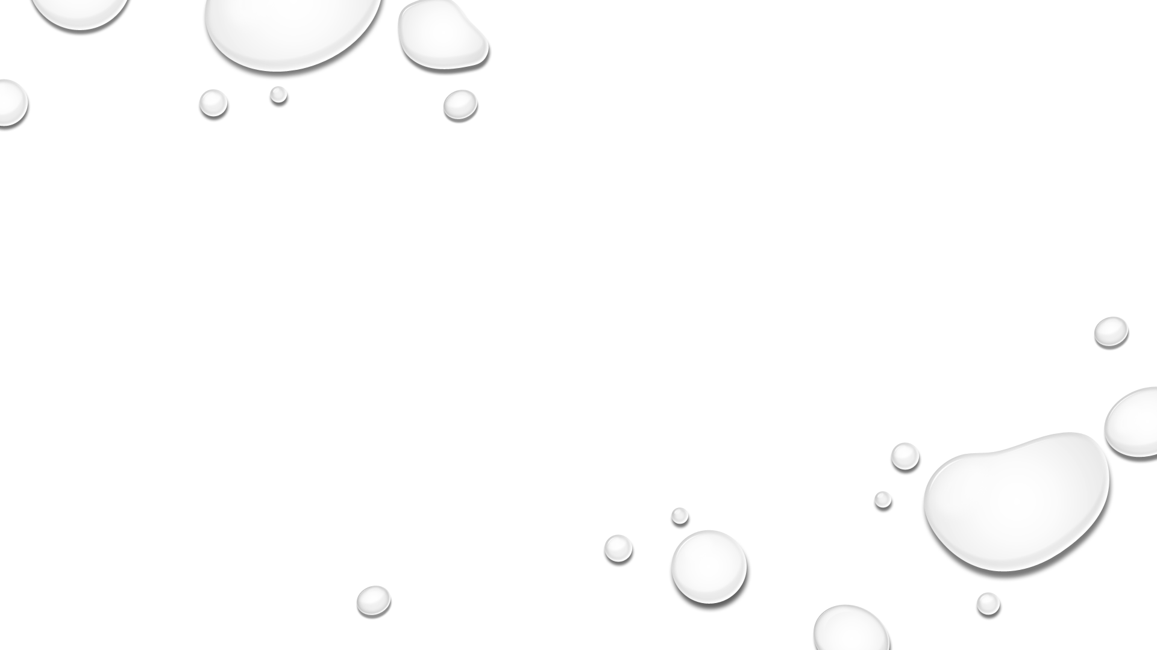

WELCOME TO
BEAUTY THERAPY DIPLOMA PROGRAM
Level 1

Slide 2
beauty THERAPY program level 1
Hygiene, health and safety
Skin anatomy
Structure of the skin
Skin types
Skin blemishes
Ph balance
Skin analysis

Slide 3
Level 1
Hygiene, health and safety:
The principles of health and safety
Difference between hazard & risk
How to protect yourself and the client
Method of controlling infections
Type of infections
SKIN ANATOMY:
Structure of the skin
Skin layers
( Epidermis , dermis and hypodermis )

Slide 4
LEVEL 1
Skin types:
The 4 main skin types
How to identify each skin type
Skin blemishes:
Hypo-pigmentations
Keloids
Crows feet
Ph balance
Skin analysis

Slide 5
HEALTH AND Safety
Why is health and safety important IN THE WORK PLACE ?
No worker should be forced to work in an environment where his or her health at risk . it is also makes good business sense to ensure that all of your workers are both healthy and safe. This will impact on the reputation of the work.
Customers, visitors need to be informed about the rules and behaviors to ensure they also take responsibility for their safety.
Example : following instructions from signs provided, such as not walking across a wet floor where a sign has been displayed. Everyone has responsibility for maintaining health and safety.

Slide 6
The principles of health and safety
Employers must :
Provide and maintain safe working environment.
Provide safe systems of work.
Provide information, training and supervision.
Ensure storage and movement of goods and materials.
Provide and maintain safe equipment.
Providing training sessions for beauty therapy to develop skills and product knowledge.
Providing uniform.

Slide 7
The principles of health and safety
Employees must :
Co-operate with the other employees to fill the duties.
Follow the health and safety protocols.
Report all accidents that happened in the facility .
Mandatory attendance at training sessions.
Ensuring they present a professional image.

Slide 8
First AID
Health and safety (first aid) :
A box containing equipment needed to give immediate medical help in an emergency.
The regulations require employers to provide adequate and appropriate equipment, facilities and personnel to enable first aid to be given to employees who are injured or become ill at work.
It can help reduce the risk of infection or the severity of an injury. First aid kits typically include a variety of supplies that will help treat cuts, scrapes and injuries, including sprains and burns.

Slide 9
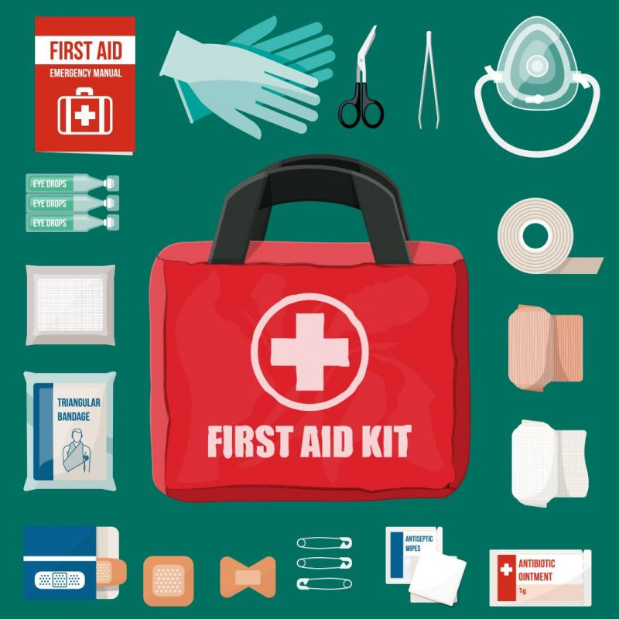
First AID

Slide 10
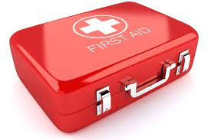
First AID

Slide 11
FIRST AID
- It's important to have a well-stocked first aid kit in your home so you can deal with minor accidents and injuries.
- Your first aid kit should be locked and kept in a cool, dry place out of the reach of children.
- It may also be useful to keep a basic first aid manual or instruction booklet with your first aid kit.
- Medicines should be checked regularly to make sure they're within their use-by dates.

Slide 12
FIRST AID
A basic first aid kit may contain :
Plasters in a variety of different sizes and shapes
Small, medium and large sterile gauze dressings
At least 2 sterile eye dressings
Triangular bandages
Rolled bandages
Safety pins
Disposable sterile gloves
Tweezers

Slide 13
FIRST AID
Alcohol-free cleansing wipes
Sticky tape
Skin rash cream
Antiseptic cream
Antihistamine cream or tablets
Distilled water for cleaning wounds
Eye wash and eye bath
Scissors

Slide 14
The principles of health and safety
Safety : The absence of risk .
Work place : Any area or building where people work.
Health and safety policy:
A document outlining an employer policy and commitment to health and safety.
Accident : An unplanned and controlled event with the potential to cause injury.

Slide 15
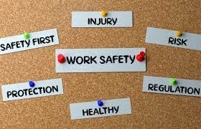
The principles of health and safety

Slide 16

The principles of health and safety

Slide 17
The principles of health and safety
Therapist personal hygiene :
Take a daily bath.
Avoid heavy perfumes.
Using an anti- bacterial soap.
Rubbing hands together for at least 15 – 20 seconds between each client
Using a clean towel or a disposable paper towel..
Clean shoes and uniform (comfortable shoes).

Slide 18
Hazard and risk
These terms have both totally different meanings and totally different functions. Let’s take a look at definitions for both words:
Hazard: Something that could potentially cause harm.
Risk: The degree of likelihood that harm will be caused.
A hazard can cause harm, a risk is how likely it is to do so.
The two terms work together to enable employers fully assess their working environment for potential dangers and priorities them effectively.

Slide 19
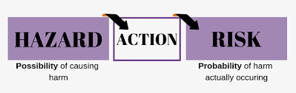
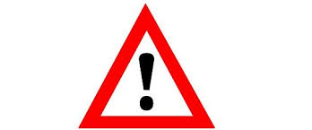
Hazard and risk
Example :
Hazard : using the chemical peel to do a treatment.
Risk : not wearing protective gloves when handling the chemical peel.

Slide 20
How to protect yourself and the client
The principles of health and safety
The important method to hygiene (health &safety):
Not treating clients who have an obvious infection.
Sterilising equipment.
Disposing of waste safety.
Maintaining the highest standards of hygiene.
Hands must be washed before and after each client.
Using hand sanitiser/ alcohol.
Wearing face mask and gloves and to be changed for each client.

Slide 21
The principles of health and safety
The important method to hygiene (health &safety):
All surfaces should be daily washed down with effective disinfectant / sanitiser example: (floors, worktops, machines and trolleys) etc …
Couch roll should be covered the bed for each new client.
Clean towels must be used for each client.
Clean robes for each client.
General waste and medical waste should be cheeked daily.
Broken glass or needles must be disposed of in a sharps box.
Knowing the difference between medical waste and general waste .

Slide 22
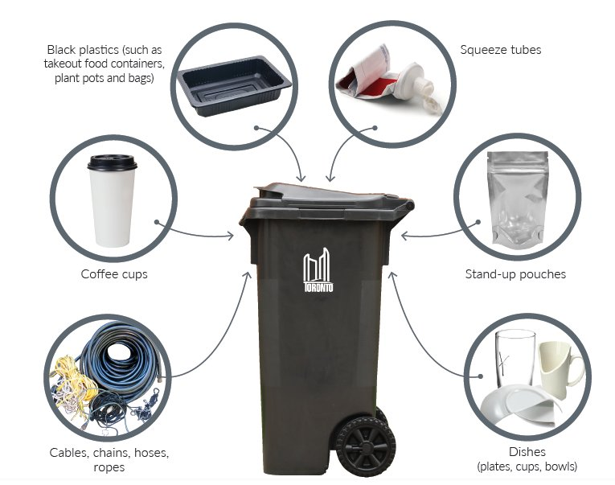
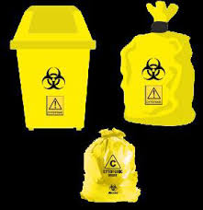
The principles of health and safety

Slide 23
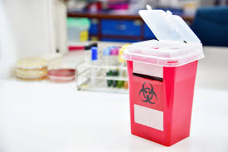
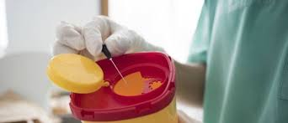
The principles of health and safety

Slide 24
How to protect yourself and the client
How to prevent infection between clients:
Using disposable spatulas to remove the products in containers for the treatment use.
Placing small amount of products in a clean glass container.
Never using fingers into the products.
Never return any product that has been taken from the main container, if it contacts with either your hands or any part of the client.
Using cotton pads, tissues etc. Should be immediately disposed in a covered waste bin.

Slide 25
Method of controlling and prevent infections
A client can pick up an infection from equipment that has not been properly cleaned and sterilised or from products that has deteriorated.
To prevent the spread of bacteria, viruses or fungus within your working environment , variety of sterilisation methods and techniques are available in any medical clinic.
Here are some of the most suitable methods:
Autoclave
Disinfectant liquids & solutions
Chemical sterilisers
Hot bead steriliser

Slide 26
Method of controlling and prevent infections
1) Autoclave:
Is a machine that uses steam under pressure to kill harmful bacteria, viruses, fungi, and spores on items that are placed inside a pressure vessel. The items are heated to an appropriate sterilization temperature for a given amount of time.
Autoclaves are commonly used in healthcare settings to sterilize medical devices. The items to be sterilized are placed inside a pressure vessel, commonly referred to as the chamber. Three factors are critical to ensuring successful steam sterilization in an autoclave: time, temperature and steam quality.

Slide 27
Method of controlling and prevent infections
The size of the sterilizer will vary based on the capacity needed for the area where the autoclave will be used.
There is a time/temperature relationship for proper steam sterilization which has been developed by scientific testing and is used in all sterilization methods to create what is known as the total exposure phase. Exposure periods for steam sterilization vary with size, shape, weight, density and material composition of the device being sterilized, among other factors.

Slide 28
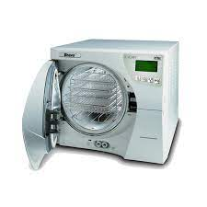

Method of controlling and prevent infections

Slide 29
Method of controlling and prevent infections
2) Disinfectant liquids & Solutions :
Typical beauty centre products are either chemical disinfectants that may require dilution according to their instructions for use, or alcohol- based disinfectants that may be used in the forms of liquids, wipes, or gel- based hand washes.

Slide 30
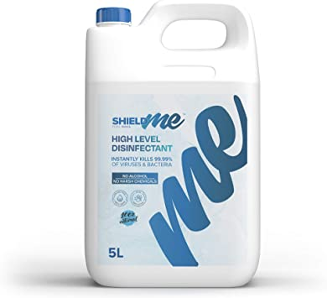
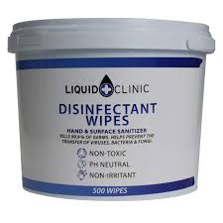
Method of controlling and prevent infections

Slide 31
Method of controlling and prevent infections
3) Chemical Sterilisers :
Chemical sterilant are used in healthcare to chemically treat surgical instruments and medical supplies to ensure infectious pathogens are not transmitted to patients. Common chemical sterilant used in healthcare.
Choosing a sterilization method is key critical for a variety of reasons.
All-around choice and it should be looked at as a first, go-to option for sterilization needs.

Slide 32
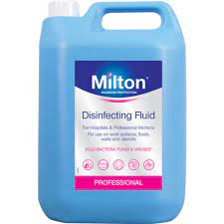
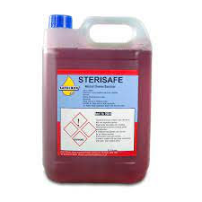
Method of controlling and prevent infections

Slide 33
Method of controlling and prevent infections
4) Hot Bead Steriliser:
This compact unit provides a quick and easy way to sterilize surgical instruments.
Simply insert an instrument into the beads and, within 15 seconds, the submerged portion of the instrument is sterilized.
These units kill most of classes of fungi, bacteria and virus.

Slide 34
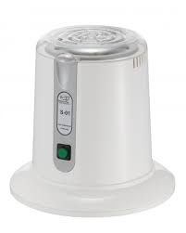
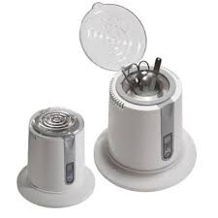
Method of controlling and prevent infections

Slide 35
Type of infections
What is a skin infection?
Your skin is the largest organ of your body. Its function is to protect your body from infection. Sometimes the skin itself becomes infected. Skin infections are caused by a wide variety of germs, and symptoms can vary from mild to serious. Mild infections may be treatable with over-the-counter medications and home remedies, whereas other infections may require medical attention.

Slide 36
Type of infections
What are the types of skin infections?
1) bacterial skin infection
Bacterial skin infections often begin as small, red bumps that slowly increase in size. Some bacterial infections are mild and easily treated with topical antibiotics, but other infections require an oral antibiotic. Different types of bacterial skin infections examples:
Impetigo
Boils
Acne

Slide 37
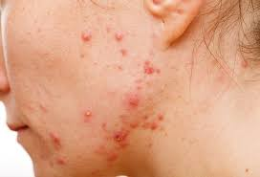
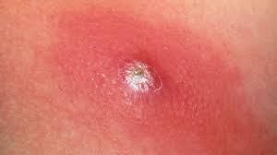
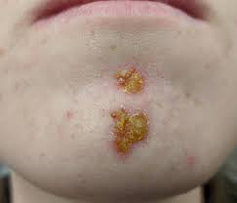
Type of infections
ACNE
BOILS
iMPETIGO

Slide 38
Type of infections
2) Viral Skin Infections
Viral skin infections are caused by a virus. These infections range from mild to severe. Different types of viral infections include:
Herpes zoster
Warts
Chickenpox

Slide 39
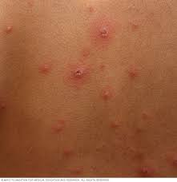
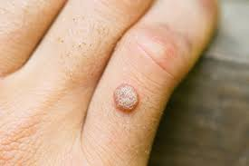
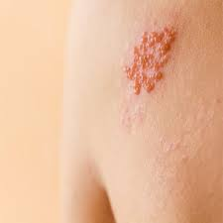
Type of infections
CHICKENPOX
WART
HERPES ZOSTER

Slide 40
Type of infections
3) Fungal Skin Infections:
These types of skin infections are caused by a fungus and are most likely to develop in damp areas of the body, such as the feet or armpit. And these infections are typically non-life-threatening.
Different types of fungal infections:
Nail fungus
Ringworm
ORAL THRUSH

Slide 41
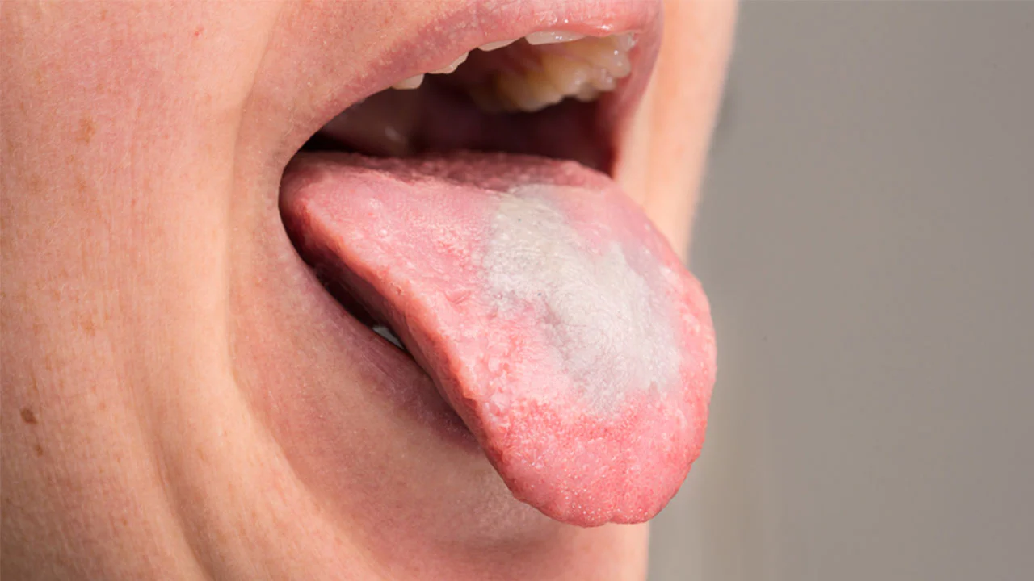
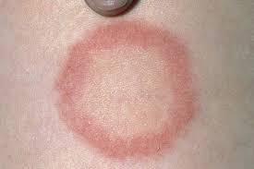
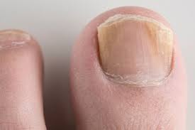
Type of infections
ORAL THRUSH
RINGWORM
Nail fungus

Slide 42
skin anatomy
A good working knowledge of the underlying structure and function of the bones, muscles and physiological system of the body will help you increase the benefits of the therapies you provide to your clients.
The skin is the largest organ in the body, made of water, protein, fats and minerals.
Meaning of the following:
Anatomy: Study of the body structure.
Physiology: Study of the body function.
Dermatology: The scientific study of the skin and its disease and disorders.

Slide 43
skin anatomy
The skin is the largest and most complex organ in the body. In an average adult the skin covers about 2 square meters and makes up about 12 – 15% of the total body mass.
The skin covers the whole body, is water- resistant and has many functions including protecting and shaping the body.
There are 3 layers:
1) The Epidermis
2) Dermis
3) Subcutaneous layer ( hypodermis)

Slide 44
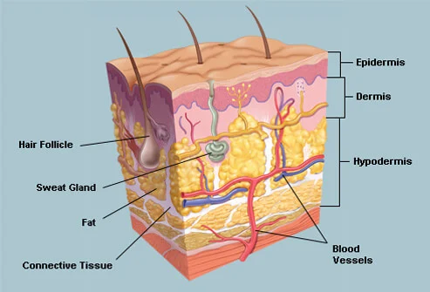
skin anatomy

Slide 45
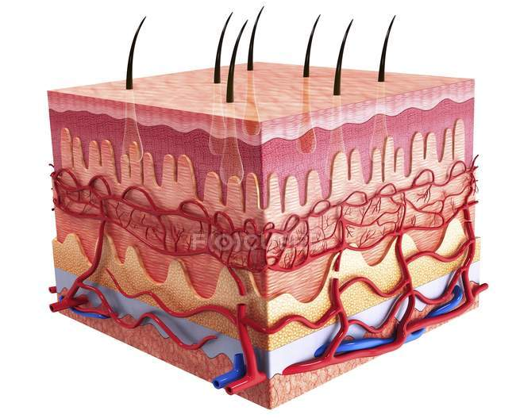
skin anatomy

Slide 46
Structure of the skin
( Epidermis )
The epidermis layer is the outermost layer of skin on your body and the layer that we can only see. It protects your body from harm, keeps your body hydrated, produces new skin cells and contains melanin, that gives the skin color .
It is thickest on the soles of the feet and palms of the hand and thinnest on eyelids
There is no blood supply to the epidermis, hardly any nerve supply and it receives nutrients and fluids from the lymphatic vessels in the dermis.

Slide 47
Structure of the skin
( Epidermis )
The epidermis consist of 5 layers:
Stratum corneum- surface layer
Stratum lucidum- clear layer
Stratum granulosum- granular layer
Stratum spinosum- prickle cell layer
Stratum germinativum/ basale- basal layer

Slide 48
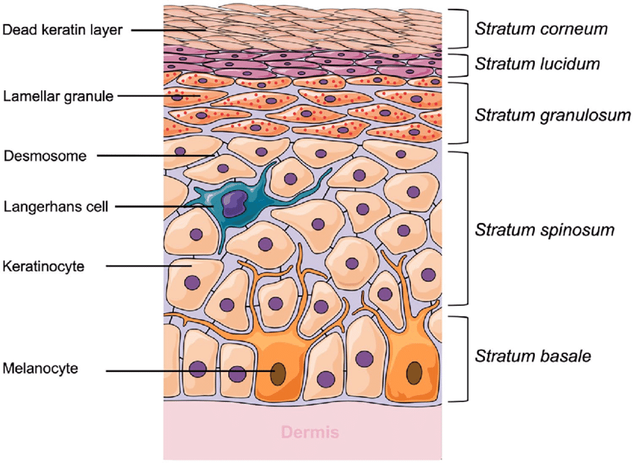
Structure of the skin
( Epidermis )

Slide 49
Structure of the skin
( Epidermis )
1) Stratum Corneum- the surface:
This is the layer of the epidermis that we can see.
This layer also consists of fats that keep water from easily entering or leaving your body.
Is made up of hardened, flattened, dead keratinised cells.
Has an invisible cell membrane.
It eventually shed as new keratinocyte cells develop in the stratum basale layer and move through the other layers of skin.

Slide 50
Structure of the skin
( Epidermis )
2) Stratum Lucidum- clear layer:
Denucleated cells but not completely hard.
Most easily visible under a microscope (only on palms & soles).
Cell membranes becoming visible.
Is a thin, transparent layer of keratinocytes that are becoming less round and have a flatter shape.

Slide 51
Structure of the skin
( Epidermis )
3) Stratum Granulosum- granular layer:
Cells have a distinct nucleus .
Cell membranes are dying.
Contain granules which are visible in healing tissue after trauma.

Slide 52
Structure of the skin
( Epidermis )
4) Stratum Spinosum- prickle cell layer:
Cells are living and membranes are intact.
They have fibrils which interlock.
This layer helps your skin to be flexible and strong.

Slide 53
Structure of the skin
( Epidermis )
5) Stratum Germinativum/ basale- basal layer:
The primary site of cell division.
New skin cells develop in this layer.
Keratinocytes it’s a cell which produce the protein keratin.
In this layer the cells are made , and they are living.
They take about 28- 30 days to move up from here through the 5 layers of the epidermis before being shed.
This layer contains a pigment known as melanin that gives skin its natural colour, whether red, yellow or black. Melanin is produced by cells called melanocytes.

Slide 54
functions of the epidermis
What are the functions of the epidermis?
Each layer of your skin works together to keep your body safe, including your skeletal system, organs, muscles and tissues. The epidermis has many additional functions, including:
1) Hydration: The outermost layer of the epidermis (stratum corneum) holds in water and keeps your skin hydrated and healthy.

Slide 55
functions of the epidermis
2) Producing new skin cells: New skin cells develop at the bottom layer of your epidermis (stratum basale) and travel up through the other layers as they get older. They reach the outermost layer of your epidermis after about a month, where the skin cells shed from your body as new cells develop at the bottom layer.
3) Protection: The epidermis acts like armor to protect your body from harm, including ultraviolet (uv) radiation, pathogens (bacteria, viruses, fungi and parasites) and chemicals.
4) Skin color: The epidermis has cells called melanocytes which make melanin, which is a group of pigments in your skin that provides skin color.

Slide 56
Structure of the skin
( Epidermis )
How does the epidermis help with other organs?
In conjunction with your other layers of skin, the epidermis protects your skeletal system, organs, muscles and tissues from harm.
Where is the epidermis located?
The epidermis is the top layer of your skin, and it’s what you see or feel when you look at or touch another person.

Slide 57
Structure of the skin
( Epidermis )
What are the 3 major cells that make up the epidermis?
The epidermis contains different types of cells, including:
Keratinocytes: Keratinocytes produce the protein keratin, which is the main component of the epidermis.
Melanocytes: Melanocytes make your skin pigment, known as melanin.
Langerhans cells: Langerhans cells prevent things from getting into your skin.

Slide 58
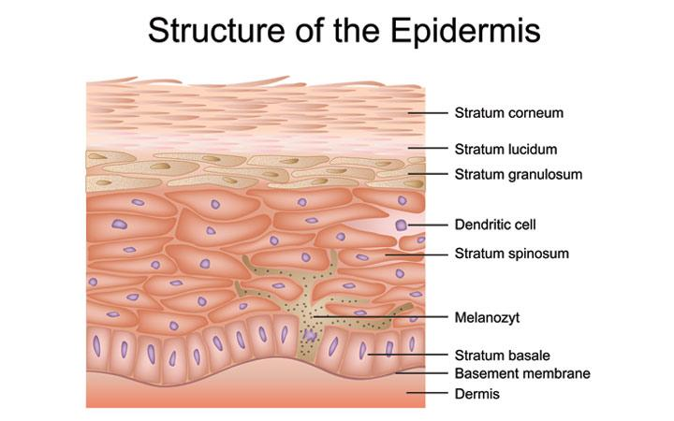
Structure of the skin
( Epidermis )

Slide 59
Structure of the skin
( dermis )
The dermis is commonly known as the true skin.
The dermis is a connective tissue layer sandwiched between the epidermis and subcutaneous tissue. The dermis is a fibrous structure composed of collagen, elastic tissue
The role of the dermis is to support and protect the skin and deeper layers.
The dermis contains sweat and sebaceous glands, hair follicles and many living cells.

Slide 60
Structure of the skin
( dermis )
- It is made of connective tissue, mainly areolar tissue which is tough and elastic, and contains white collagen fibres and yellow elastic tissue know as elastin.
Collagen plumps the skin and elastin keeps it supple and elastic, both diminish with age.
- The two proteins are closely associated and work together, they have two totally opposing jobs.

Slide 61
Structure of the skin
( dermis )
What are the two layers of the dermis?
1) Reticular layer: The reticular layer is the bottom layer of your dermis. It’s thick, and it contains blood vessels, glands, hair follicles, lymphatics, nerves and fat cells. A net-like structure of elastin fibers and collagen fibers surrounds the reticular dermis. These fibers support your skin’s overall structure, as well as allow it to move and stretch.
2) Papillary layer: The papillary layer is the top layer of your dermis. It’s much thinner than the reticular dermis. It consists of collagen fibers, fibroblast cells, fat cells.

Slide 62
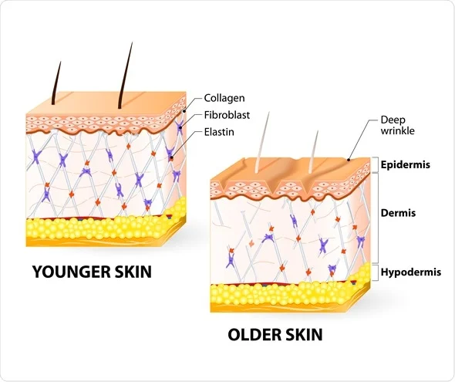
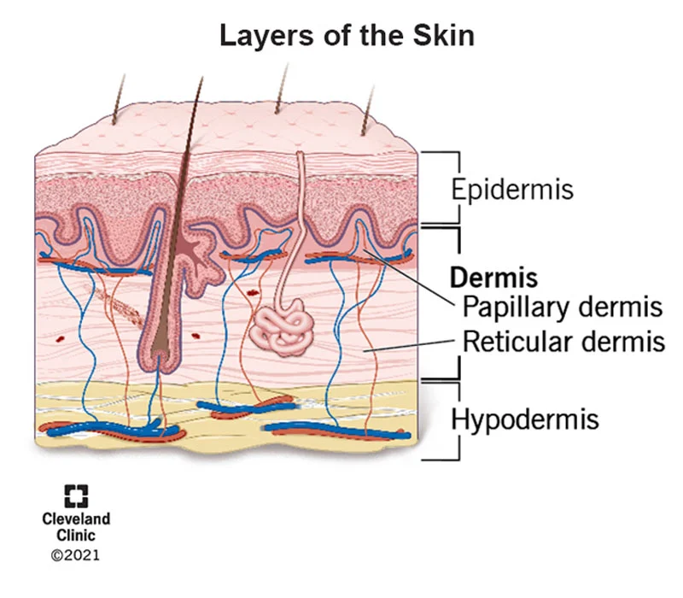
Structure of the skin
( dermis )

Slide 63
functions of the dermis
What are the functions of the dermis?
Each layer of your skin works together to protect your body. The dermis has many additional functions, including:
1) Supporting your epidermis: Your dermis’s structure provides strength and flexibility, and blood vessels help maintain your epidermis by transporting nutrients.
2) Feeling different sensations: Nerve endings in your dermis allow you to feel different sensations, like pressure, pain, heat, cold and itchiness.

Slide 64
functions of the dermis
3) Producing Sweat: Your dermis contains sweat glands, which produce sweat when you’re hot or experience stress. Sweat helps control your body temperature .
4) Keeping your skin moist: Your dermis contains sebaceous glands, which secrete an oily lubricant (sebum) that helps keep your skin and hair hydrated and shiny.
5) Producing hair: Your dermis contains hair follicels , which produce hair all over your skin, except the palms of your hands and the soles of your feet.

Slide 65
Structure of the skin
( dermis )
Where is the dermis located?
Your dermis is the middle layer of your skin, located between your epidermis (top layer) and hypodermis (bottom layer) in your skin.
What is the dermis’s structure?
Your dermis consists of two layers — the reticular dermis and the papillary dermis

Slide 66
Structure of the skin
( dermis )
Dermis LAYER contains 8 main types of structures:
Specialised cells
Nerve endings
Sweat glands
Hair follicles
5. Sebaceous glands
Blood supply
Lymphatic capillary
Papilla

Slide 67
Structure of the skin
( dermis )
1) Specialised Cells:
Fibroblasts: responsible for the production of areolar tissue, elastin and collagen. Fibroblasts can be damaged by UV lights.
Mast cells: produce histamine as an allergic response
Histiocytes: also produce histamine
Leucocytes: white blood cells which help to fight infection and disease

Slide 68
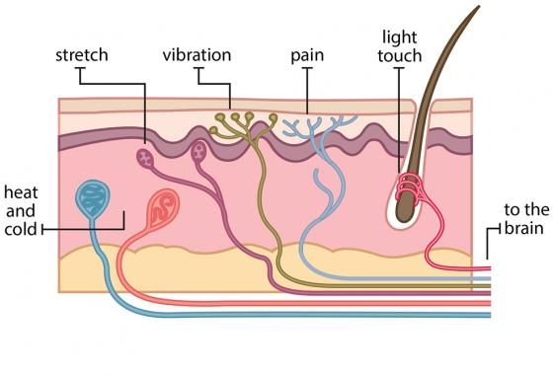
Structure of the skin
( dermis )
2) Nerve Endings:
It’s a message sent to the brain when we feel any sensation like : heat, cold, pressure and pain.
Part of the defence system of the body

Slide 69
Structure of the skin
( dermis )
4) Sweat Glands:
Stretch from the dermis to the epidermis to excrete toxins. Sweat mainly contains water, urea and salt and is produced by 2 kinds of glands:
Eccrine: These excrete watery sweat and control body temperature.
Apocrine: These are found in the groin and axillae (armpits), and excrete a milky fluid which when mixes with bacteria on the surface of the skin produces body odour.

Slide 70
Structure of the skin
( dermis )
4) Hair Follicles:
Travel through the epidermis and dermis.
Hair follicles : it’s a long tube that stands the root and the hair.
Erector pili : it’s a tiny muscles called that attached to each hair and help with the temperature control of the body by pulling the hair upright.
There are 3 stages for the hair : * Anagen * Catagen *Telogen

Slide 71
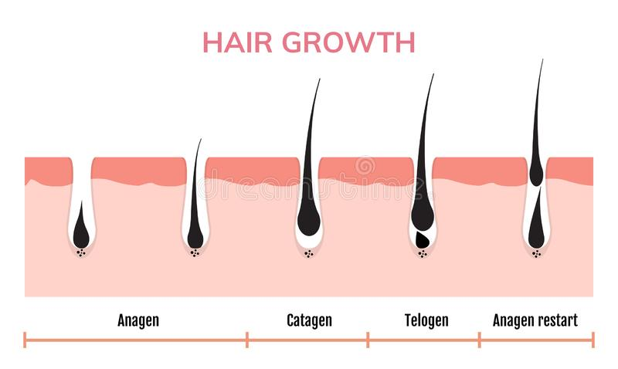
Structure of the skin
( dermis )

Slide 72
Structure of the skin
( dermis )
5) Sebaceous Glands:
Connected with hair follicles and produce sebum : it a fatty acid which keeps the skin moist and which lubricates the hair shaft. They are therefore found in hairy areas.
Sweat and sebum combine on the surface of the skin to form the acid mantle, a protective shield which helps to control bacteria levels and prevents infections and disease and also acts as a natural moisturiser. The ph balance of the skin is 4.5- 5.6 and this acid environment helps to prevent bacterial growth.

Slide 73
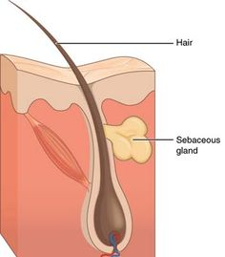
Structure of the skin
( dermis )

Slide 74
Structure of the skin
( dermis )
6) Blood Supply:
A system of blood vessels including microscopic capillaries which are one cell thick.
7) Lymphatic Capillary:
Works in conjunction with the blood supply to carry waste products away from the area.
8) Papilla:
Small conical projections at the base of the hair.
Contains blood vessels and nerves which supply the hair with nutrients.

Slide 75
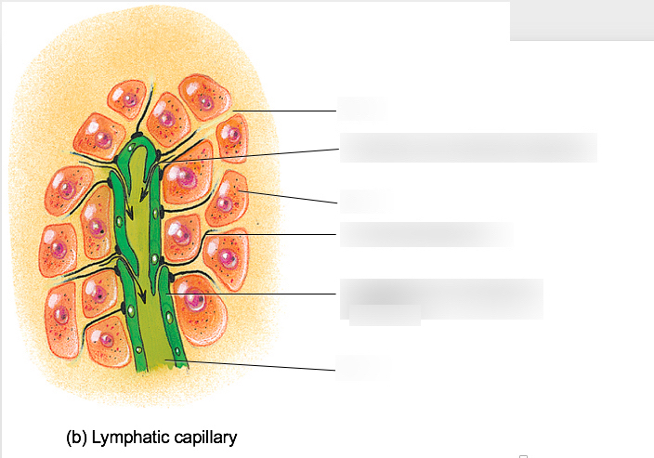
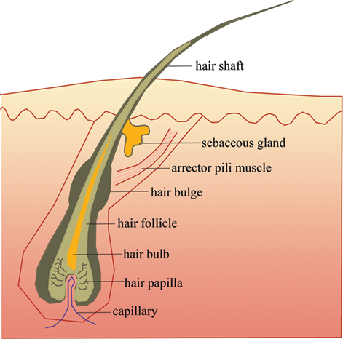
Structure of the skin
( dermis )
Lymphatic cappilary
papilla

Slide 76
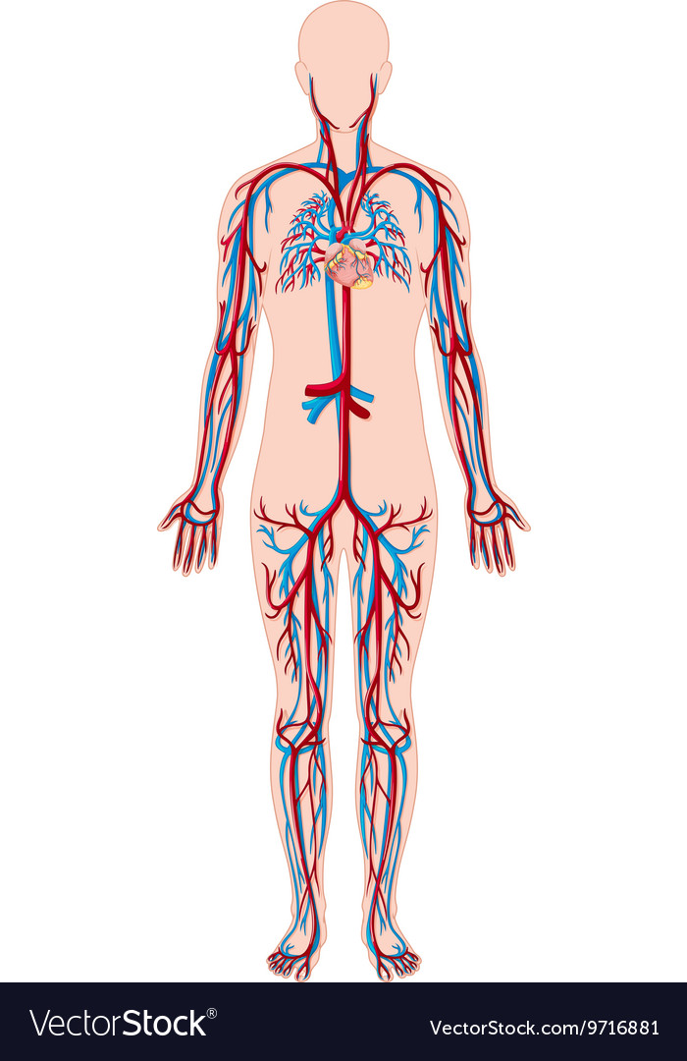
Structure of the skin
( dermis )
Blood supply

Slide 77
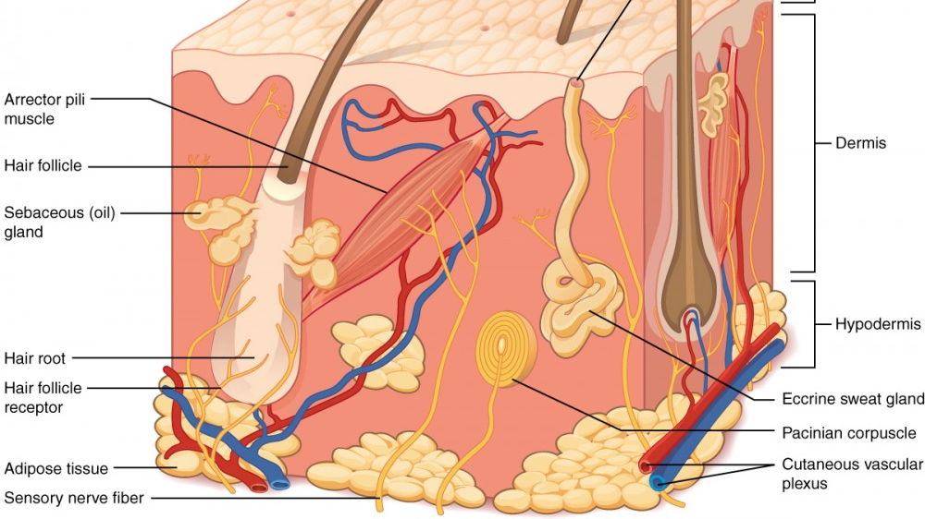

Slide 78
Structure of the skin
( Hypodermis )
Hypodermis layer is the bottom layer of skin in your body. It has many functions, including :
Insulating your body
Protecting your body from harm
Storing energy and
Connecting your skin to your muscles and bones

Slide 79
Structure of the skin
( Hypodermis )
What is in the hypodermis layer?
The hypodermis layer includes:
1) Adipose tissue: Adipose tissue is a fatty tissue that consists mostly of adipocytes.
2) Blood vessels: Blood vessels include arteries, capillaries and veins. They circulate blood throughout your body, help deliver oxygen to vital organs and remove waste products.

Slide 80
Structure of the skin
( Hypodermis )
3) Connective tissue: The proteins collagen and elastin make up the connective tissues in your body. They connect all of the structures in your body and provides a support structure for other components of the hypodermis.
4) Fibroblasts: Fibroblasts are a type of cell in your connective tissue. They release collagen, which helps make up your connective tissue.
5) Lymphatic vessels: Lymphatic vessels are the network of capillaries (micro vessels) and a large network of tubes located throughout your body that transport waste products (lymph) away from tissues.

Slide 81
Structure of the skin
( Hypodermis )
Where is the hypodermis located?
The hypodermis is the bottom layer of your skin, located below the epidermis (top layer) and dermis (middle layer) in your skin.
What is the hypodermis made of?
Connective tissue and adipose tissue mostly make up the hypodermis.

Slide 82
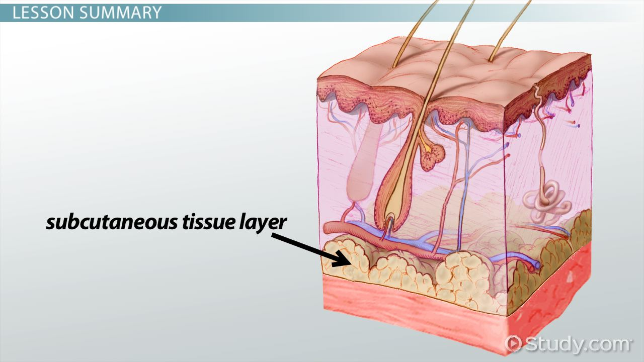
Structure of the skin
( Hypodermis )

Slide 83
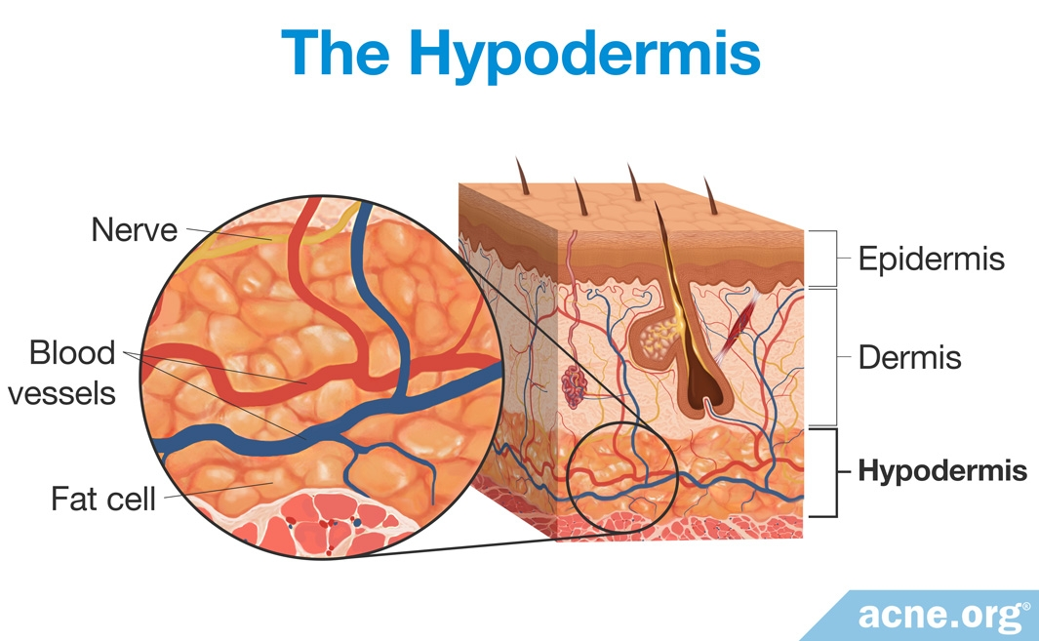
Structure of the skin
( Hypodermis )

Slide 84
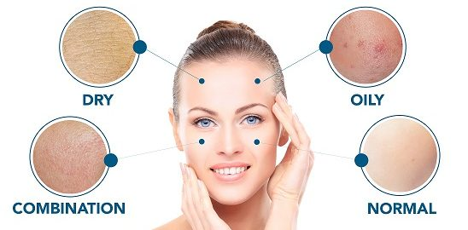
skin types
Skin is classified according to several factors related to its balance: Sebaceous secretion, hydration and sensitivity level. Thus, each type of skin will have its own characteristics and require different cares. The type of skin is determined by genetics, although it will also be affected by other factors and can change with time.

Slide 85
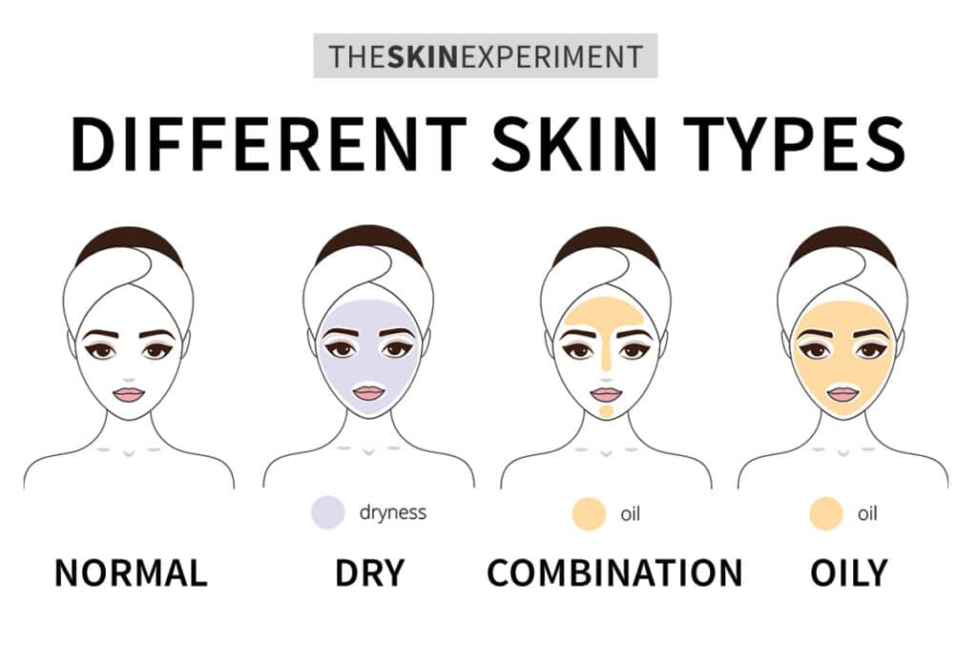
skin types

Slide 86
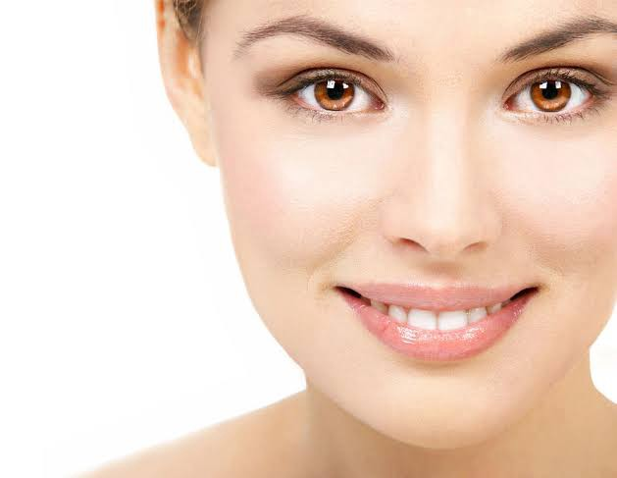
skin types
1) Normal Skin :
‘Normal’ is a term widely used to refer to well-balanced skin. The scientific term for healthy skin.
This well-balanced healthy skin type has even levels of moisture and hydration, uniform texture and no obvious problem areas.

Slide 87
skin types
Characteristics of normal skin type:
Free from skin blemishes.
Pores are fine, hardly visible.
Skin tone is even, clear, and smooth.
Skin is neither too oily or too dry.
Good blood circulation.
Soft and smooth texture
And not prone to sensitivity

Slide 88
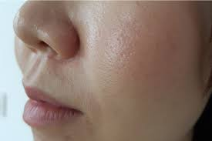
skin types
2) Oily Skin Type:
Humid and bright appearance, it is caused by excessive fat production by sebaceous glands, and usually determined by genetic and/or hormonal causes.
If you don't treat your oily skin, pores can become clogged and enlarged, and dead skin cells may accumulate. Blackheads, pimples and other types of acne are also common with this skin type

Slide 89
skin types
Characteristics of oily skin type:
Shiny and often has breakouts.
Less visible wrinkles.
Visible and enlarged looking pores.
Make up may wear off easily.
A glossy shine.
Oily skin is prone to comedones / milia (blackheads / whiteheads).

Slide 90
skin types
3) Dry Skin Type :
Dry skin is caused by external factors such as the weather.
Dry' is used to describe a skin type that produces less sebum than normal skin. As a result of the lack of sebum, dry skin lacks the lipids that it needs to retain moisture and build a protective shield against external influences.
Dry skin signs and symptoms may vary depending on different factors such as age, health status or their cause. It is generally characterized by a feeling of tightness and roughness. It may also acquire an ashy gray color, with occurrence of desquamation, itching, redness and small cracks.

Slide 91
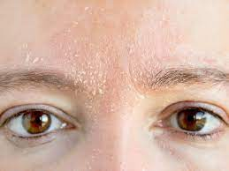
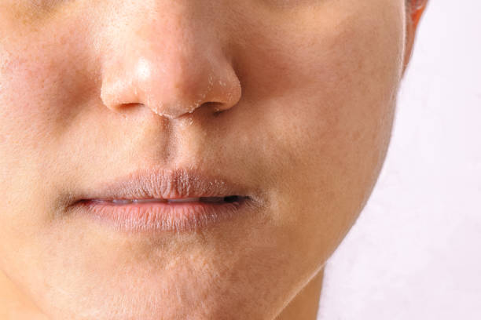
skin types

Slide 92
skin types
Characteristics of dry skin type:
Skin feels tight and brittle, lacks elasticity.
Skin texture feels rough.
Complexion looks dull and blotchy.
Scaling, flaking, and itchiness.
Prone to redness.
Barely visible pores.
Chapping and prone to cracking.
Enhances fine lines and wrinkles.

Slide 93
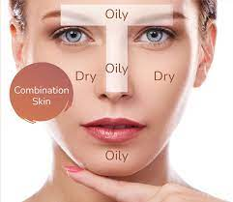
skin types
4) Combination Skin Type :
The combination type is characterized by dry, flaking skin on the cheeks, while excessive oil and shine appears on other areas of the face. Those with combination skin are in a constant battle with their t-zone, which includes the forehead, nose, and chin.

Slide 94
skin types
Characteristics of combination skin type:
An oily t-zone (forehead, chin and nose).
Enlarged pores in the t zone .
Normal to dry cheeks.

Slide 95
skin types

Slide 96
Fitzpatrick skin phototype
The Fitzpatrick skin type describes a way to classify the skin by its reaction to exposure to sunlight.
At skin renewal, each client is booked for a consultation with a doctor before any treatments are done. As every person has a unique set of needs, an individualized package is worked out for each client to ensure optimal results.
Here are the scale colures : pale, fair, medium, olive, naturally brown, and very dark brown/black.

Slide 97
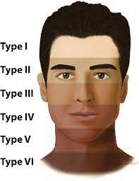
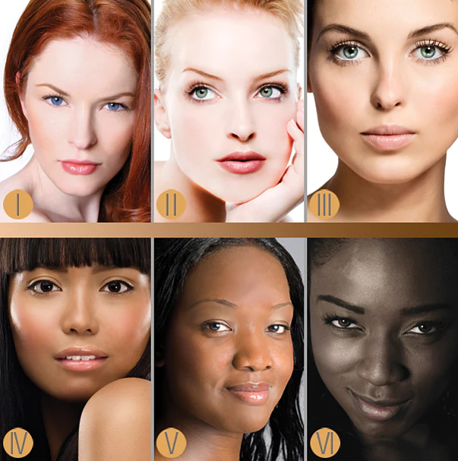
Fitzpatrick skin phototype

Slide 98

Fitzpatrick skin phototype

Slide 99

Fitzpatrick skin phototype

Slide 100

Fitzpatrick skin phototype

Slide 101
skin blemishes
A blemish is any type of mark, spot, discoloration, or flaw that appears on the skin. Blemishes on the face may be unsightly and emotionally upsetting, but most are benign and not life-threatening. Some blemishes, however, can signal skin cancer.
Seeking medical treatment or using at-home remedies may help reduce the appearance of blemishes.
In this article, we outline the different types of blemish that people may have and the treatment options available in each case.

Slide 102
skin blemishes
1) Hyper Pigmentation: Is a type of blemish that appears darker than other areas of skin, caused by increased melanin, possibly indicating sun damage, medication and hormonal problems.
2) Open Pores: Due to greasy skin or a mature client with dry skin due t a previous skin condition. The open pores are filled with dirt, oil, bacteria, and dead skin cells.
It leads to the formation of blackheads, whiteheads, and acne or pimples formation.

Slide 103


skin blemishes
Open pores
Hyperpigmentation

Slide 104
skin blemishes
3) Dehydrated Skin : It caused by lack of water rather than natural oil.This condition can affect any skin type, the problem maybe related to the client’s general health, lifestyle, diet and skin care.
The skin will have fine superficial lines, superficial flacking and broken capillaries are common. Advise your client to drink more water and avoid caffeine ,alcohol, smoking and extremes of temperature in addition to using the correct skin care products.

Slide 105


skin blemishes
Dehydrated skin
Dehydrated skin

Slide 106
skin blemishes
4) Sensitive Skin : Is a common condition and means your skin is more prone to reactions such as redness and itching.. Sensitive skin require visit to the dermatologist. Many clients are complaining of sensitivity or allergy to products that come into contact with their skin, this skin is easily irritated and can look like dry skin, usually with high colour and signs of dilated capillaries. It is easily stimulated, often becoming red and blotchy, and responds quickly to treatment, so care is needed.

Slide 107


skin blemishes
Sensetive skin
Sensetive skin

Slide 108
skin blemishes
5) Broken Capillaries: Tiny walled blood vessels close to the surface of the skin which dilate and break usually found on the nose cheeks area and are caused by extremes of temperature or over stimulation of the tissues. Sensitive skin is more at risk from this condition it often appears blue because of the congestion in the area and transparent skin.
Bleeding into the skin happens when small blood vessels burst just below your skin's surface.
Laser skin treatments. One of the most effective options available that can greatly reduce the appearance of broken capillaries in the face

Slide 109


skin blemishes
Broken cappillary
Broken cappillary

Slide 110
skin blemishes
6) Hypo Pigmentation : Is a low amount of melanin in your skin. Patches of your skin are lighter in color. Your skin get the color from a pigment called melanin. When your skin cells don’t make enough melanin, areas of your skin become lighter. R than your surrounding skin.
What causes hypopigmentation?
Injuries to your skin are the most common cause of hypopigmentation, including:
Burns.
Infections.
Blisters.
Chemical exposure.

Slide 111


skin blemishes
Rare genetic conditions may cause hypopigmentation over wide areas of your skin. Some of these genetic conditions include:
Albinism
Vitiligo
Vitiligo
Albinism

Slide 112
skin blemishes
How is hypopigmentation treated?
Hypopigmentation treatment depends on what caused your skin to lighten.
Always send these cases to the dermatology doctor.
Certain things may help improve the appearance of your hypopigmentation like :
1) Cosmetics: Makeup help to make hypopigmentation less visible.
2) Sunscreen: The sun can be especially damaging to areas of your skin with hypopigmentation, use sunscreen with a sun protection factor (spf) to help protect your affected areas.

Slide 113
skin blemishes
7) Keloids: Is a thick raised scar, when skin is injured, fibrous tissue called scar tissue forms over the wound to repair and protect the injury. In some cases, extra scar tissue grows, forming smooth, hard growths called keloids.
Keloids can be much larger than the original wound.
Keloids can affect any part of the body.
Keloids come from the overgrowth of scar tissue. Keloid scars tend to be larger than the original wound itself.

Slide 114
skin blemishes
Reason : Most types of skin injury can contribute to keloid scarring, these include:
Acne scars
Burns
Chickenpox scar
Ear piercing
Scratches
Treatment : Always send the case to the dermatology doctor .

Slide 115


skin blemishes
Keloids
Keloids

Slide 116

skin blemishes
.
8) Crow’s Feet: The wrinkles located in the corner of the eye, there are two different types of wrinkles: dynamic and static.
Dynamic wrinkles are those that appear during muscle contraction.
Static wrinkles may worsen with muscle contraction, but they are visible all the time, even when the face is at rest.
Crow's feet

Slide 117
skin blemishes
.
9) Milia (Whiteheads) : Is a small, white bump that typically appears on the nose and cheeks. These cysts are often found in groups. Multiple cysts are called milia. They’re usually not itchy or painful. However, they may cause discomfort for some people.
T’s common to confuse the white bumps on your face with whiteheads, which are a type of acne.
Milia aren’t a type of acne.
About 40% to 50% of u.S. Newborns have milia, adults can get milia too.

Slide 118
skin blemishes
.
What causes milia?
Trapped dead skin cells that form cysts below the surface of your skin cause milia. Your body naturally gets rid of dead skin cells by shedding them to make room for new cells to grow and take their place. When your old skin cells don’t fall off of your body, new skin grows on top of them and traps them underneath. Your dead skin cells harden and turn into cysts.

Slide 119
skin blemishes
.
10) Comedones (Blackheads):
Comedonal acne occurs when a hair follicle is blocked by sebum (a waxy skin oil) and dead skin cells.
A single bump is referred to as a comedo, while multiple bumps are called comedones.
Comedones are not red or inflamed like a typical pimple.
Comedones can sometimes become acne pimples if you try to pop them, allowing bacteria easy access to broken tissue.

Slide 120
skin blemishes
.
There are several types of comedonal acne blemishes :
Closed comedones: commonly referred to as whiteheads, range in color from creamy white to flesh-toned. Whiteheads are not painful. They cannot be popped since they do not contain pus or an underlying infection.
Open comedones: the dark color isn't caused by dirt but rather a chemical reaction in melanin, the pigment responsible for the color of skin.

Slide 121



skin blemishes
.
MILIA
COMEDONES
COMEDONES

Slide 122
skin blemishes
.
11) Papules: A small inflamed ,superficial raised area of the skin that is solid and lacking in fluid / pus.
Papules are by definition, small, usually less than a centimeter in size, which is about the width of your fingernail. Your papule may have a dome shape, or it may be flat on the top.
However, if the papules appear soon after you start a new medication, consult your doctor immediately.

Slide 123
skin blemishes
.
12) Pustule : A small inflamed ,superficial raised of the skin that is filled with fluid.
They show up when you have some sort of infection, and your body is trying to fight it off with white blood cells. That can result in a mixture of infected fluid and dead white BLOOD CELLS (pus).
Pustules are small red bumps with white or yellowish centers. They may be tender or sore to the touch.

Slide 124


skin blemishes
.
Papule
Pustule

Slide 125

skin blemishes
.

Slide 126
skin blemishes
.
13) Lack of Elasticity : Is your skin’s ability to stretch and then bounce back. Loss of skin elasticity is known officially as elastosis – the degeneration of skin tissue due to ageing and other factors. And solar elastosis occurs to areas of the skin which have too much exposure to the sun and appear more weathered as a result.
Young skin contains plenty of collagen and elastin, the proteins which give skin its structure and ability to stretch. As we age, these start to decline due to hormonal changes and our ability to heal also slows down, leading to decreased skin elasticity.

Slide 127


skin blemishes
.
Lack of Elasticity

Slide 128


skin blemishes
.

Slide 129
ph balance
.
Our skin has a thin, protective layer on its surface, referred to as the acid mantle . this mildly acidic ph is created by our acid mantle (combination of sweat and sebum) on the surface of the skin. It acts as a protective shield which helps to control bacteria levels and prevents infections and disease and also acts as a natural moisturizer. A neutral ph balance is 7 (that is pure water).
When skin is at its optimal level, barrier function and moisture retention improves. Slightly acidic skin also helps normal (healthy) bacterial flora remain attached to the epidermis.

Slide 130
ph balance
.
Why does skin’s ph balance matter?
Skin’s ph is 4.5 /5.6 plays an important role in skin condition. The acid mantle is key to skin’s protective barrier. Inhibits the growth of bacteria and restores and maintains the optimal acid environment in which skin’s natural flora can thrive.
What can affect the skin’s ph?
External factors:
Climate and environment
Sun U.V.
Cosmetics and antibacterial products.
Medical products and chemicals

Slide 131
ph balance
.
Internal factors:
Genetics
Age
Hormones
Sebum
Sweat
Stress
The ph of male and female skin differs slightly. The average ph of male skin is lower due to higher rate of sebum production in male skin.

Slide 132
ph balance
.
We can help to support skin’s optimum ph with healthy lifestyle choices, a regular skincare routine and by using products that respect skin’s natural ph and maintain its protective barrier.
Acidity is measured on ph scale, which can range from zero to 14. If the ph is lower than 7, it is acidic and if it is higher than 7, it is alkaline. A ph of seven is neutral.

Slide 133

ph balance
.

Slide 134
skin analysis
.
A skin analysis is the process of understanding the current and past history of your skin, this may involve sebum, pores, wrinkles, spots, and moisture tests.
Most professionals such as; dermatologists, aesthetic clinics, cosmetic clinics, and skincare companies are utilizing diagnostic tools or devices to conduct these tests.

Slide 135
skin analysis
.
This process normally involves capturing micro-zoom high-resolution images, every person is unique that’s why personal information such as; age, gender, and skin type are also important contributing factors to the results of the analysis.
Some skin analyzers offers product recommendations to address the needs of your skin.
* How long does the whole skin analysis process take?
An in-depth skin analysis normally takes 15 minutes, this may involve taking images, asking questions about your skin history and analyzing the results of the tests.

Slide 136
skin analysis
.
The main benefits of having your skin analyzed are:
The ability to change your skin with the correct treatments .
Choose the right home skin care to main the results.
Can address hidden sun damage, pigmentation, blocked pores, wrinkles and fine lines.
It will allow you to stop signs of damage before they reach the surface of your skin.

Slide 137
skin analysis
.
Information to be included in the skin analysis session and to be recorded.
1) The client’s skin type
2) Pigmentation and skin colour
3) Skin texture
4) Treatment plan
5) Client medical history
6) Client goal before starting any skin treatment

Slide 138
skin analysis
.
Many external factors affect your skin. So we have to consider the following questions ?
Are you under stress?
Do you get enough sleep?
Do you have any allergies?
Are you exposed to the sun often?
Does your skin react to specific treatment or product ?

Slide 139
skin analysis
.
Do you smoke ?
When it was your last facial or any skin treatment ?
What it was your last session of laser hair removal ?
Are you drinking enough water daily ?
Are you pregnant or breast feeding ?

Slide 140


skin analysis
.

Slide 141


skin analysis
.

Slide 142
BEAUTY THERAPY DIPLOMA PROGRAM
Level 2

Slide 143
beauty THERAPY program level 2
.
Skin consultation
Contraindication
Skin disease and disorders
Vitamins and minerals
Benefits of a healthy diet
The muscular system
Face muscles
The lymphatic system
The circulatory system

Slide 144
skin consultation
.
A professional skin consultation should be the first step you take when you’re considering starting treatments or skincare. The process allows you to gain advice on what is best for your individual needs and concerns.
Recommend skin consultations it should be to every new client that visits or enquires about any treatment or home care advise .
It’s also a great feeling hearing advice from a skin expert who is keen to help you. We follow a skin consultation process before any treatments like :

Slide 145
skin consultation
.
1) Filling out consultation form:
This form contains general and lifestyle information, medical history and current skin routine questions and what could be causing certain concerns and any medication we need to be aware of.
2) Observe skin analysis:
Is the process of understanding the current and history of your skin, this may involve sebum, pores, wrinkles, spots, and moisture tests.

Slide 146
skin consultation
.
3) The discussion:
This step is the most important for us, this is where we are able to connect with you and figure out why you have decided to visit us. We discuss your skin history, health, lifestyle, current skincare routine and several other factors that could be the reason.
4) Visual analysis:
We proceed to take you through into one of our facial rooms, we always look under the magnifying lamp to see pore size, blackheads, texture and any other concerns you may not have pointed out.

Slide 147
skin consultation
.
5) Recommendations:
To make this process easier for you, we always write down everything we have discussed during your consult. You will be taking home a skincare home prescriptive booklet.
Explaining the skin treatment plan and number of sessions.
And taking care of the lifestyle and/or diet.

Slide 148
skin consultation
.
The consultation of the skin and treatment should determine:
Skin type , skin elasticity skin texture
The pore size.
Contraindication to treatment
Pigmentation and skin colour
Skin blemishes’
Area want treat .
Choose the correct products to treat
Advise the client on home care treatment.

Slide 149

skin consultation
.

Slide 150

skin consultation
.

Slide 151
contraindication
.
Is a condition that serves as a reason not to take a certain medical treatment due to the harm that it would cause the patient.
Why it is important ?
It might be unsafe for the client and caused several problems .
Contraindication is the opposite of indication, which is a reason to use a certain treatment.

Slide 152
contraindication
.
Skin treatments contraindications :
Pregnancy
Active acne
Sun exposure
Fever
Fungal
Bacterial infections
Cancer
Unstable blood pressure

Slide 153
skin disease & disorders
There are 6 types :
Immune diseases
Bacterial
Viral
Fungal
Pigmentation disorders
General

Slide 154
skin disease & disorders
1) Congenital diseases:
Eczema: can be found all over the body or in certain areas. The skin becomes extremely dry and itchy causing varying degrees of discomfort. The skin has scaly dry patches with bleeding at points.
Psoriasis: chronic inflammatory skin diseases characterised by red patches covered with silvery scales that are constantly shed. Affects whole body or specific areas like face and scalp, not infectious

Slide 155


skin disease & disorders
Eczema
Psoriasis

Slide 156
skin disease & disorders
2) Bacterial :
Acne vulgaris: Normally cause by hormonal imbalance which increase sebum production leading to blocked glands and infection. The skin has a shiny appearance with papules, pustules and comedones. Skin is prone to pores.
Boil : A bacterial infection of the skin causing inflammation around the hair follicle.
Folliculitis: Bacterial infection of the hair follicle and sebaceous gland causing inflammation.

Slide 157



skin disease & disorders
Acne vulgaris
BOIL
Folliculitis

Slide 158
skin disease & disorders
3) Viral Infection :
Chickenpox: Is a common childhood infection and more than 90% of individuals over the age of 15 years are thought to have had it. Chickenpox starts with itchy red spots that can appear anywhere across the body.
Shingles : Also known as herpes zoster, is commonly with a painful blistering rash. The rash can commonly leave patients with a burning sensation.

Slide 159

skin disease & disorders
Chickenbox
Shingles

Slide 160
skin disease & disorders
4) Fungal :
Ringworm : Is a common skin infection that is caused by a fungus. It’s called “ringworm” because it can cause a circular rash (shaped like a ring) .
Yeast infection : Normally found on your skin, an infection can also happen if you have a weak immune system..

Slide 161


skin disease & disorders
Ringworm
Yeats infection

Slide 162
skin disease & disorders
5) Pigmentation : Is the coloring of a person’s skin. When a person is healthy, their skin color will appear normal. In the case of illness or injury, the person's skin may change color, becoming darker (hyperpigmentation) or lighter (hypopigmentation).
Hyperpigmenttation : Is caused by an increase in melanin, the substance in the body that is responsible for color (pigment) examples:
Melasma : This condition is characterized by tan or brown patches.

Slide 163
skin disease & disorders
Hypopigmentation : Is the result of a reduction in melanin production examples:
Vitiligo: Causes smooth, white patches on the skin.
Albinism: Caused by the absence of an enzyme that produces melanin, this results in a complete lack of pigmentation in skin, hair, and eyes.

Slide 164


skin disease & disorders
MELASMA
MELASMA

Slide 165

skin disease & disorders
VITILIGO
ALBINISM

Slide 166
skin disease & disorders
6) General disorders:
Skin disorders vary greatly in symptoms and severity. They can be temporary or permanent and may be painless or painful. Some have situational causes, while others may be genetic. Some skin conditions are minor, and others can be life-threatening.
Contact the dermatology doctor to have the right diagnose and treatment.
Examples :
Acne: breakouts on the skin composed of blackheads, whiteheads, pimples, or deep, painful cysts . may leave scars or darken the skin if untreated.

Slide 167
skin disease & disorders
Rosacea: Chronic skin disease that goes through cycles of fading . common symptoms raised, red bumps, skin dryness, and skin sensitivity.
Eczema: Yellow or white scaly patches that flake off, affected areas may be red, itchy, greasy, or oily.
Psoriasis : Silvery, sharply defined skin patches.
Melanoma : The most serious form of skin cancer, more common in fair-skinned people, mole that has changed color or gotten bigger over time.
Contact dermatitis: Rash has visible borders and appears where your skin touched the irritating substance .Skin is itchy and red.

Slide 168


skin disease & disorders
Acne
Rosacea

Slide 169


skin disease & disorders
Eczema
Psoriasis

Slide 170


skin disease & disorders
Melanoma
Contact dermatitis

Slide 171
vitamins & minerals
The beauty of the skin is that you can affect it from both inside and out.
Eating fruits and vegetables rich in antioxidants is good for your whole body including your skin.
This article looks at the best foods for keeping your skin healthy:
Fatty fish
Avocado
Nuts and seeds
Sweet potatoes

Slide 172
vitamins & minerals
Broccoli
Tomatoes
Dark chocolate
Green tea
Red grapes
Make sure you’re getting enough essential nutrients to protect your skin. The foods on this list are great options to keep your skin healthy, strong, and attractive.

Slide 173



vitamins & minerals
avacado
Tomatoes
Nuts and seeds

Slide 174



vitamins & minerals
Dark chocolate
Broccoli
Green tea

Slide 175
vitamins & minerals
Making sure you get enough vitamins can keep your skin looking healthy and youthful. This could translate to a reduction in:
Dark spots
Redness
Wrinkles
Rough patches
Excessive dryness
Essential skin vitamins are available in supplemental form, but they are also found in skin care products. They can let the skin achieve optimum skin health.

Slide 176
vitamins & minerals
Vitamin D : Is important to boost immunity and stimulate cell growth in order to keep your skin healthy and even create new hair follicles to improve hair growth.
Sources of vitamin D :
Salmon
Tuna
Cheese
Beef liver

Slide 177
vitamins & minerals
Vitamin c known as ascorbic acid : This incredible antioxidant, anti-inflammatory nutrient is known to improve skin tone and texture, hydrate the skin, and reduce signs of aging.
Benefits of using vitamin C :
Keep the skin plum
Glowing
Brighten
Even skin tone
Anti aging

Slide 178
vitamins & minerals
Dark circels
Hyperpigmentation
Reduce fine lines and wrinkles
Sources of vitamin C :
Grapefruit
Orange
Strawberry
Lemon

Slide 179
vitamins & minerals
Vitamin B1 known as thiamine: Helps the body generate energy from nutrients, thiamin is necessary for the growth, development and function of cells.
Most people get enough thiamin from the food they eat.
Sources of vitamin B1:
Banana.
Nuts.
Cereals.
Liver.

Slide 180
vitamins & minerals
Vitamin B3 known as niacin: It helps keep your nervous system, digestive system and skin healthy. It helps protect skin cells from sun damage.
Sources of vitamin B3:
Brown rice
Baked potato
Grilled chicken breast

Slide 181
vitamins & minerals
Vitamin B5 known as pantothenic acid: It is needed for healthy skin, hair, eyes, and liver. They also help the nervous system function properly.
Sources of vitamin B5:
Fresh meats
Corn
Lentil
Broccoli

Slide 182
vitamins & minerals
Vitamin A : known as Retinol, Helps to speed up healing, prevent breakouts and support the skin's immune system and it promotes natural moisturizing , which means it helps to hydrate the skin effectively, giving it a radiant glow.
Both the upper and lower layers of skin need vitamin a. It seems to prevent sun damage by interrupting the process that breaks down collagen.
Sources of vitamin A:
Spinach
Carrots
Sweet potatoes

Slide 183
vitamins & minerals
Vitamin E : Acts as an antioxidant, helping protect cells from damage throughout your body. It's found in our sebum (skin oil), which creates a natural barrier to keep moisture in your skin.
Sources of vitamin E :
Almonds
Sunflower seeds
Peanut butter
Spinach

Slide 184
vitamins & minerals
Vitamin B12 : Is necessary for cell reproduction and can be applied topically for skin benefits because it reduces inflammation, dryness, and acne.
Sources of B12:
Dairy products
Liver
Beef

Slide 185


vitamins & minerals

Slide 186
vitamins & minerals
Minerals, particularly trace minerals, are very involved in the various protective properties of your skin. Trace minerals have been shown to be essential in fighting the damages of excessive sun exposure, wrinkles, and maintaining the moisture in your skin.
There are several minerals that can boost skin health:
Zinc: A proven anti-inflammatory.
Zinc oxide: A key sunscreen ingredient, zinc oxide helps protect the skin from sun damage

Slide 187
vitamins & minerals
Magnesium : It regulates cellular regeneration and repair.
Iron: Optimizing the skin's wound healing function and minimizing the appearance of bruises.
Calcium : An integral part of wound healing and skin-cell regeneration.
Potassium: It supports the rapid growth of new cells. This function helps your skin look young, healthy and glowing.
Phosphorus: Needed for the growth, maintenance, and repair of all tissues and cells.

Slide 188


vitamins & minerals

Slide 189
Benefits of a healthy diet for the skin
When people talk about diet, they usually speak about weight, but did you know that what we eat can also impact the health and appearance of our skin? While we usually reach for skin care products to treat and care for our skin, our diet can help to rejuvenate our skin from the inside out.
The things we eat and what our body ingests has much greater impact on the overall appearance and condition of our skin. A healthy diet includes raw minerals, vitamins and other nutrients, acids, and other useful compounds that our skin and body needs daily bases.

Slide 190
Benefits of a healthy diet for the skin
Here we will discover the many benefits of a healthy diet on your skin:
Moisturizing effects.
Prevent wrinkles.
Fights acne.
Makes your skin radiant.
Keeps the area around your eyes protected.

Slide 191

Benefits of a healthy diet for the skin

Slide 192
Benefits of a healthy diet for the skin
Lifestyle management tips for healthy skin:
Hydration: water is essential for keeping skin supple and moisturized, drink enough water depending on your age, gender, physical activity, and medical conditions.
Avoiding inflammatory foods: sebaceous glands of the face get stimulated by hormones that can be affected by inflammatory foods. Such foods: processed and packaged foods contain high amounts of these harmful fats.

Slide 193
Benefits of a healthy diet for the skin
3) Managing gut health: The first step to clear and radiant skin is fixing your gut health. Since nutrients are metabolized in the digestive system, inflammatory responses are signals given by the gut. Fermented foods and a diverse diet with fresh fruits and vegetables to improve the positive bacteria.
4) Exercise: Exercise helps cleanse your skin, boost circulation, manage stress, all of which can show up on your skin.
5) Sleep: Dermatology found that people who slept 7 to 9 hours a night had more moist skin, their skin also protected and healed itself better after being exposed to light than those who slept for 5 hours or less.

Slide 194


Benefits of a healthy diet for the skin

Slide 195
The muscular system
The muscular system is composed of specialized cells called muscle fibers. Their predominant function is contractibility. Muscles, attached to bones or internal organs and blood vessels, are responsible for movement. Nearly all movement in the body is the result of muscle contraction. Exceptions to this are the action of cilia, the flagellum on sperm cells, and amoeboid movement of some white blood cells.
The integrated action of joints, bones, and skeletal muscles produces obvious movements such as walking and running. Skeletal muscles also produce more subtle movements that result in various facial expressions, eye movements, and respiration.

Slide 196

The muscular system

Slide 197
FACE MUSCLES
Facial muscles work together to control the parts of your face. They are essential to chewing and making facial expressions. If you experience weakness or paralysis in your face muscles, seek medical attention. Although facial palsy can be a sign of a temporary, curable condition, it may also indicate a serious medical problem.
What are the facial muscles?
Your face has almost 20 flat skeletal muscles that attach to different places on your skull. The craniofacial muscles are essential to chewing and making facial expressions. They originate from bone or fascia and insert into your skin.

Slide 198
FACE MUSCLES
Craniofacial muscles work together to control movements in your:
Cheeks.
Chin.
Eyebrows.
Eyelids.
Forehead.
Lips (upper and lower).
Nose and nostrils.

Slide 199

FACE MUSCLES

Slide 200
The lymphatic system
What is the lymphatic system?
The lymphatic system is a network of tissues, vessels and organs that work together to move a colorless, watery fluid called lymph back into your circulatory system (your bloodstream).
The lymphatic system collects this excess fluid, now called lymph, from tissues in your body and moves it along until it's ultimately returned to your bloodstream.

Slide 201
The lymphatic system
Your lymphatic system has many functions:
Maintains fluid levels in your body
Absorbs fats from the digestive tract
Protects your body against foreign invaders
Transports and removes waste products and abnormal cells from the lymph

Slide 202
The lymphatic system
What are the parts of the lymphatic system?
Lymph
Lymph nodes
Lymphatic vessels
Collecting ducts
Spleen
Bone marrow

Slide 203

The lymphatic system

Slide 204
Facial Lymphatic Drainage (FLD)
What is the main function of lymphatic drainage?
Your lymphatic system is a fundamental part of the immune system. Your lymphatic system is in charge of collecting and eliminating the excess fluid, toxins and waste of your body. Using a network of hundreds of lymph nodes, it drains the lymph (a fluid that carries the waste and toxins, but also white cells). Then, the lymph returns to your bloodstream to be eliminated.

Slide 205
Facial Lymphatic Drainage (FLD)
What is facial lymphatic drainage (FLD)?
Facial lymphatic drainage is a type of massage. It uses softer and slower pumping movements. The soft pressures are directed towards the lymph nodes to eliminate toxins, fluids and waste naturally.
First, the lymph is moved from the face down to the deep lymph nodes of the neck. Then, it is drained to the thoracic area.

Slide 206
Facial Lymphatic Drainage (FLD)
Benefits of facial lymphatic drainage (FLD) :
Improve the quality of your skin.
Reduce stress and anxiety.
Improve blood flow
Make your face muscles stronger
Improve the circulation of nutrients

Slide 207

Facial Lymphatic Drainage (FLD)

Slide 208
The circulatory system
Pumps blood from the heart to the lungs to get oxygen. The heart then sends oxygenated blood through arteries to the rest of the body. The veins carry oxygen-poor blood back to the heart to start the circulation process over. Your circulatory system is critical to healthy organs, muscles and tissues.
The circulatory system provides blood to all the body's tissues so they can function.

Slide 209
The circulatory system
What does the circulatory system do?
To move blood throughout the body, this blood circulation keeps organs, muscles and tissues healthy and working to keep you alive.
Also helps your body get rid of waste products, this waste includes:
Carbon dioxide from respiration (breathing).
Other chemical byproducts from your organs.
Waste from things you eat and drink.

Slide 210
The circulatory system
The parts of your circulatory system are your:
Heart: a muscular organ that pumps blood throughout your body.
Blood vessels: which include your arteries, veins and capillaries.
Blood: made up of red and white blood cells, plasma and platelets

Slide 211


The circulatory system

Slide 212
The Skeletal system
What is the skeletal system?
The skeletal system is your body’s central framework. it consists of bones and connective tissue, including cartilage, tendons, and ligaments. it’s also called the musculoskeletal system.

Slide 213
The Skeletal system
What are the parts of the skeletal system?
The skeletal system is a network of many different parts that work together to help you move. the main part of your skeletal system consists of your bones, hard structures that create your body’s framework — the skeleton. there are 206 bones in an adult human skeleton. each bone has three main layers:
Periosteum: the periosteum is a tough membrane that covers and protects the outside of the bone.
Compact bone: below the periosteum, compact bone is white, hard, and smooth. it provides structural support and protection.
Spongy bone: the core, inner layer of the bone is softer than compact bone. it has small holes called pores to store marrow.

Slide 214
The Skeletal system
The other components of your skeletal system include:
Cartilage: this smooth and flexible substance covers the tips of your bones where they meet. it enables bones to move without friction (rubbing against each other). when cartilage wears away, as in arthritis, it can be painful and cause movement problems.
Joints: a joint is where two or more bones in the body come together. there are three different joint types. the types of joints are:
  immovable joints: immovable joints don’t let the bones move at all, like the joints between your skull bones.
  partly movable joints: these joints allow limited movement. the joints in your rib cage are partly movable joints.
  movable joints: movable joints allow a wide range of motion. your elbow, shoulder, and knee are movable joints.
Ligaments: bands of strong connective tissue called ligaments hold bones together.
Tendons: tendons are bands of tissue that connect the ends of a muscle to your bone.

Slide 215
The Skeletal system
What does the skeletal system do?
the skeletal system has many functions. besides giving us our human shape and features, it:
Allows movement: your skeleton supports your body weight to help you stand and move. joints, connective tissue and muscles work together to make your body parts mobile.
Produces blood cells: bones contain bone marrow. red and white blood cells are produced in the bone marrow.
Protects and supports organs: your skull shields your brain, your ribs protect your heart and lungs, and your backbone protects your spine.
Stores minerals: bones hold your body’s supply of minerals like calcium and vitamin d

Slide 216

The Skeletal system

Slide 217
The nervous system
Your nervous system is your body’s command center. originating from your brain, it controls your movements, thoughts and automatic responses to the world around you. it also controls other body systems and processes, such as digestion, breathing and sexual development (puberty). diseases, accidents, toxins and the natural aging process can damage your nervous system.

Slide 218
The nervous system
What are the parts of the nervous system?
the nervous system has two main parts. each part contains billions of cells called neurons, or nerve cells. these special cells send and receive electrical signals through your body to tell it what to do.
The main parts of the nervous system are:
Central nervous system (CNS): your brain and spinal cord make up your cns. your brain uses your nerves to send messages to the rest of your body. each nerve has a protective outer layer called myelin. myelin insulates the nerve and helps the messages get through.

Slide 219
The nervous system
Peripheral nervous system: your peripheral nervous system consists of many nerves that branch out from your CNS all over your body. this system relays information from your brain and spinal cord to your organs, arms, legs, fingers and toes. your peripheral nervous system contains your:
Somatic nervous system, which guides your voluntary movements.
Autonomic nervous system, which controls the activities you do without thinking about them.

Slide 220

The nervous system

